Slide 1

Electric Vehicle Charging Station Management System (EV CSMS)
2023-11-04

Slide 2

EV Charging Ecosystem

Slide 3
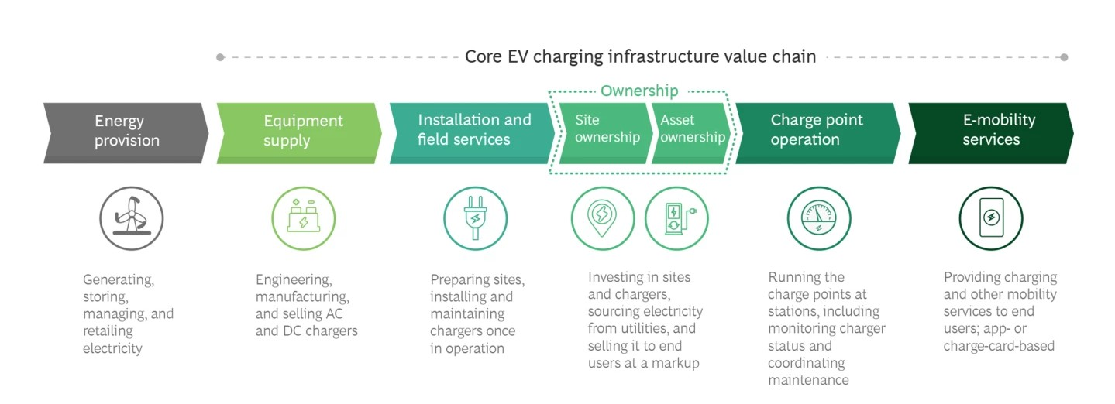
Value Chain
https://www.bcg.com/publications/2021/the-evolution-of-charging-infrastructures-for-electric-vehicles

Slide 4
Statistics

Slide 5

EVs
Number of Electric Vehicles in Traffic
  58,000 (in October 2023)
Number of Electric Vehicles Sold
  in 2023
    45,050
  in October
    8,340
https://ea-sarj.net/

Slide 6
Total Number of Charging Points in Türkiye
Number of Charging Points (Sockets) in November 2023
  11036
EV per AC Charging Point
  AC
    7.13
  DC
    19.08
DC Charging Point number leader
  Eşarj, 797
  Trugo, 364
  ZES, 301
AC Charging Point number leader
  ZES, 2649
  Voltrun, 649,
  Eşarj, 240
https://ea-sarj.net/

Slide 7
Solutions
Fault, Maintenance and Customer support management

Slide 8

Fault, Maintenance and Support Services
Customer Support Management
  Ticket Management
Fault Management
Workforce Management
  Work Order Management
Mobile Workforce Management (MWM)

Slide 9

Aim
With this platform, it is aimed to increase the Service Quality in E-mobility. (*)
  Occupational Health and Safety (*)
  Real-time fault & error tracking.
  Contributing to increasing the trust of electric vehicle users in the charging infrastructure.
  Customer satisfaction
  Ensuring efficiency and service continuity at charging stations through planned maintenance.

Slide 10
Sustainability
To Solve Problems of Electric Vehicle Charging Stations as soon as possible
Increasing the confidence in the use of Electric Vehicles by minimizing the suffering of end users
Minimizing maintenance costs through planned, predictive, preventive, etc. maintenance at charging stations will contribute to sustainability.

Slide 11
Collaboration Potential
All Electric Vehicle Charging Station Manufacturers
Charging Network Licensed Companies
Maintenance & Malfunction Subcontractor companies
All companies that need Workforce Management for charging stations

Slide 12
Services

Slide 13

Concepts
Faults
  OCPP 1.6J
    Charge Point Error Code
Call Method
Mobile Application
3rd Party Integrations
Work Order
Workforce Management

Slide 14
Workforce Management
WFM

Slide 15

Key Components
Work Order Management
Workforce Planning
Staff Scheduling
Time and Attendance Management
Labor Forecasting
Performance Management
Workforce Analytics
Occupational Health and Safety (*)

Slide 16

Work Order Type Group
Maintenance
  Preventive Maintenance
  Corrective Maintenance
  Predictive Maintenance
  Scheduled Maintenance
  Emergency Maintenance
Fault
  See Fault Group

Slide 17
Mobile Workforce Management
MWM

Slide 18

Key Components
Occupational Health and Safety (*)
Scheduling and Dispatch
Time and Attendance Tracking
Job Tracking
Communication Tools
Inventory and Asset Management
Customer Relationship Management (CRM)
Work Order Management
Document and Image Capture
Safety and Compliance
Offline Functionality
Analytics and Performance Metrics
Security and Access Control
Mobile Device Management (MDM)
Customization and Scalability

Slide 19

Thank You
Ferhat BAL
+90 532 794 65 42
ferhat.bal@evcify.com
https://evcify.com

